Slide 1
IoT: Internet of (Insecure) Things
Aurélien Francillon
Séminaire sur la Confiance Numérique,
Mai 2014

Slide 2
Overview
Introduction
  Context, embedded systems security
An attack example
  A Hard Disk backdoor
A view of the state of embedded devices
Avatar
  A better method to analyze such systems
SMART
  Status of a proactive solution
Concluding remarks

Slide 3
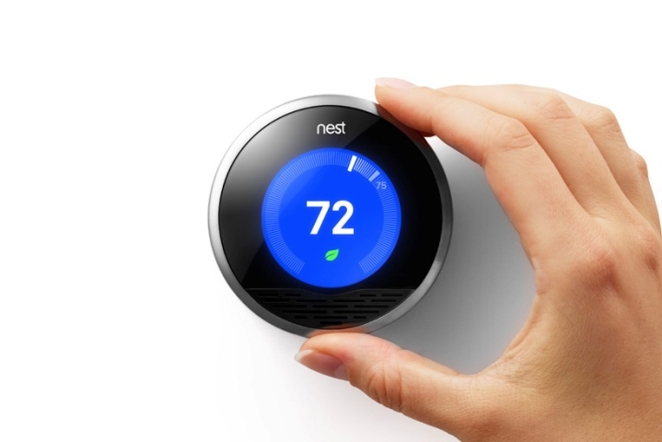
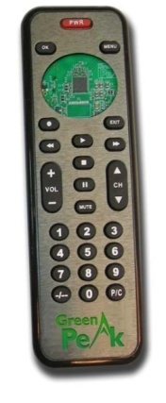
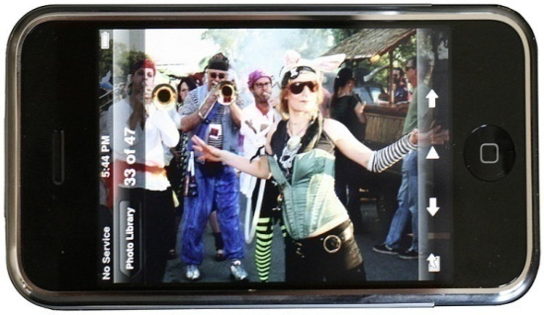

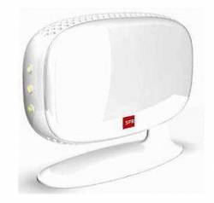
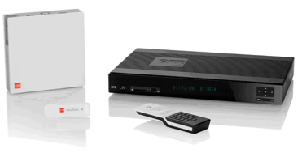


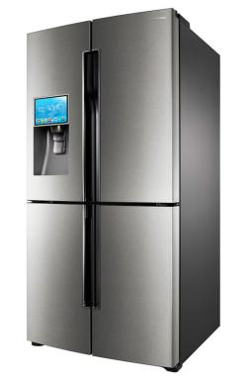
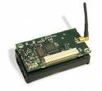
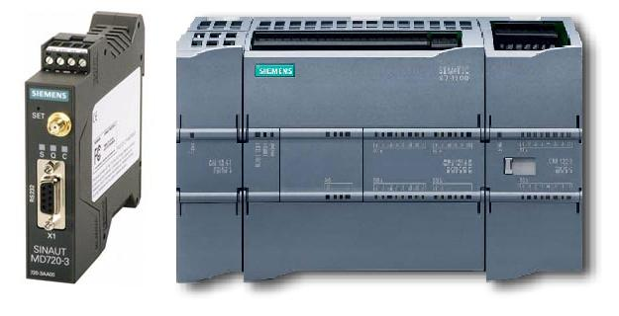
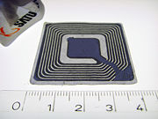
Embedded Systems Diversity
SmartCards
Connected devices
Sensors
RFID
Industrial systems
Notes:
Embedded systems are extremely diverse, in their architectures, software systems and operating systems
They are increasingly connected to various networks and to the internet…
Problem is that security devices, like paytv smart cards, were designed with security in mind, rather good evaluation and test.
Nowadays the internet of things, make our life dependent on the security of non-security-devices.
Do you think all of them are secure by design ? Flawless ?
There are little attacks on them so far maybe mainly because they are very diverse…
But this does not holds for targeted attacks (Stuxnet…)
Massive compromises alreadyu reported (100000’s)

Slide 4
Embedded Devices : Security Challenges
Embedded devices are not anymore immune to compromise
  Security devices are rather secure
  But we rely on non security devices for our daily security and privacy
But are obscure, hidden
  You know the OS you are running on your server/laptop and if it is up to date
  But when was the last update of your fridge’s OS?
Networking/wireless interfaces are increasing the attack surface
  IoT=> IoIT? Is it the Internet of the Insecure Things ?
In general difficult to know the runtime status of a device
Sophisticated attacks previously demonstrated
  Hundreds of thousands of devices compromised

Slide 5
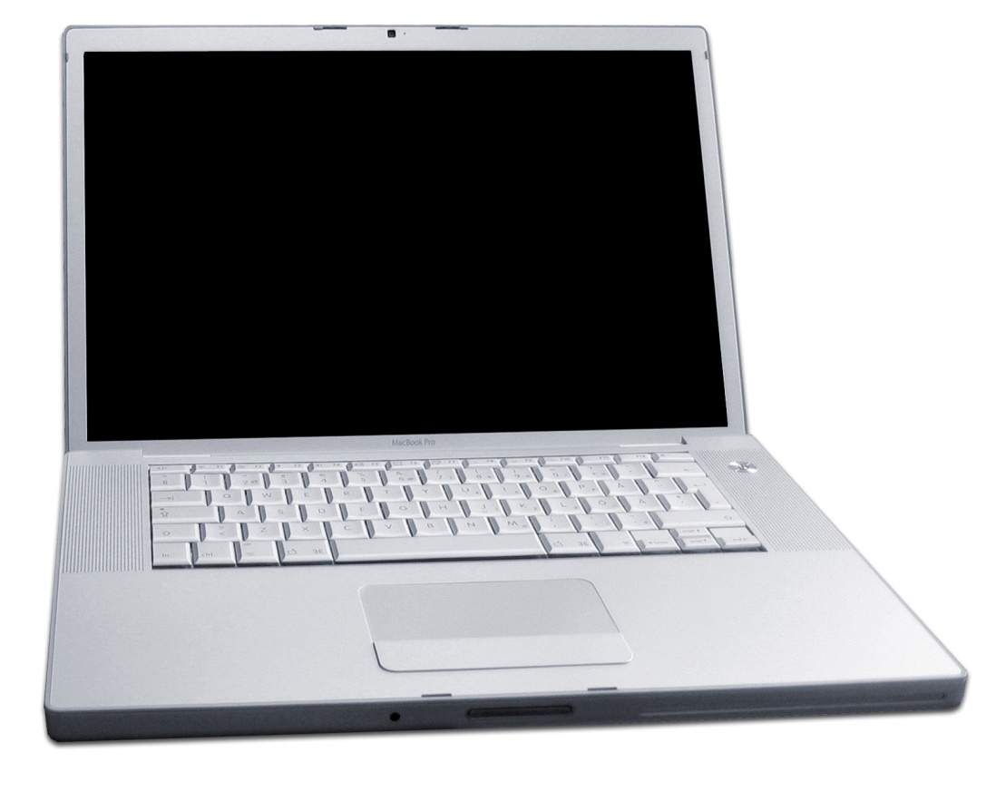
Your computer is made of many “computers”
Keyboard
controller
Network card
CPU microcode
Hard-drive
Northbridge
chipset
GPU
All of them are considered to be in our TCB.
What could happen when one is compromised?

Slide 6
Overview
Introduction
An attack example
  A Hard Disk backdoor
A view of the state of embedded devices
Avatar
SMART
Concluding remarks

Slide 7
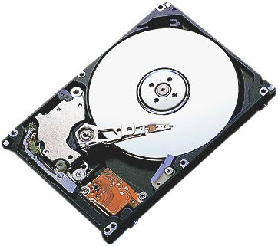




Implementation and Implications of
a Stealth Hard-Drive Backdoor
ACSAC 2013 (Best Student Paper Award)
Jonas Zaddach
Davide Balzarotti
Aurélien Francillon
Travis Goodspeed
Erik-Oliver Blass
Anil Kurmus
Ioannis Koltsidas
Moitrayee Gupta
Notes:
Test

Slide 8
Goals
It's about threat models !
  Do we care about hardware compromises ?
  Is it practical, feasible ?
An example attack would be to
  Understand, then backdoor the firmware
  Malware compromises OS
  Updates HDD with malicious firmware update
  Disk is formatted, OS “re-installed”
  But malicious HDD firmware remains!
  OS compromised again from on the next boot

Slide 9
Work done
Reverse engineered the firmware of a disk
  a Common Off The Shelf (COTS) SATA disk
Designed a backdoor
  covertly extracts data from a host/network (i.e., exfiltrates data)
Evaluated its impact and performance
Discussed countermeasures

Slide 10
Disk platters
Head
& Actuators
Controller
SATA interface
M/S pins

Slide 11
Reverse engineering approach
A serial diagnostic menu is available from M/S pins
  Gives PEEK/POKE primitives
  Allows to dump memory/load code
Understand firmware
  But it's very large and obscure...
  We need a way to debug the running firmware
  To hook the backdoor in the original code

Slide 12
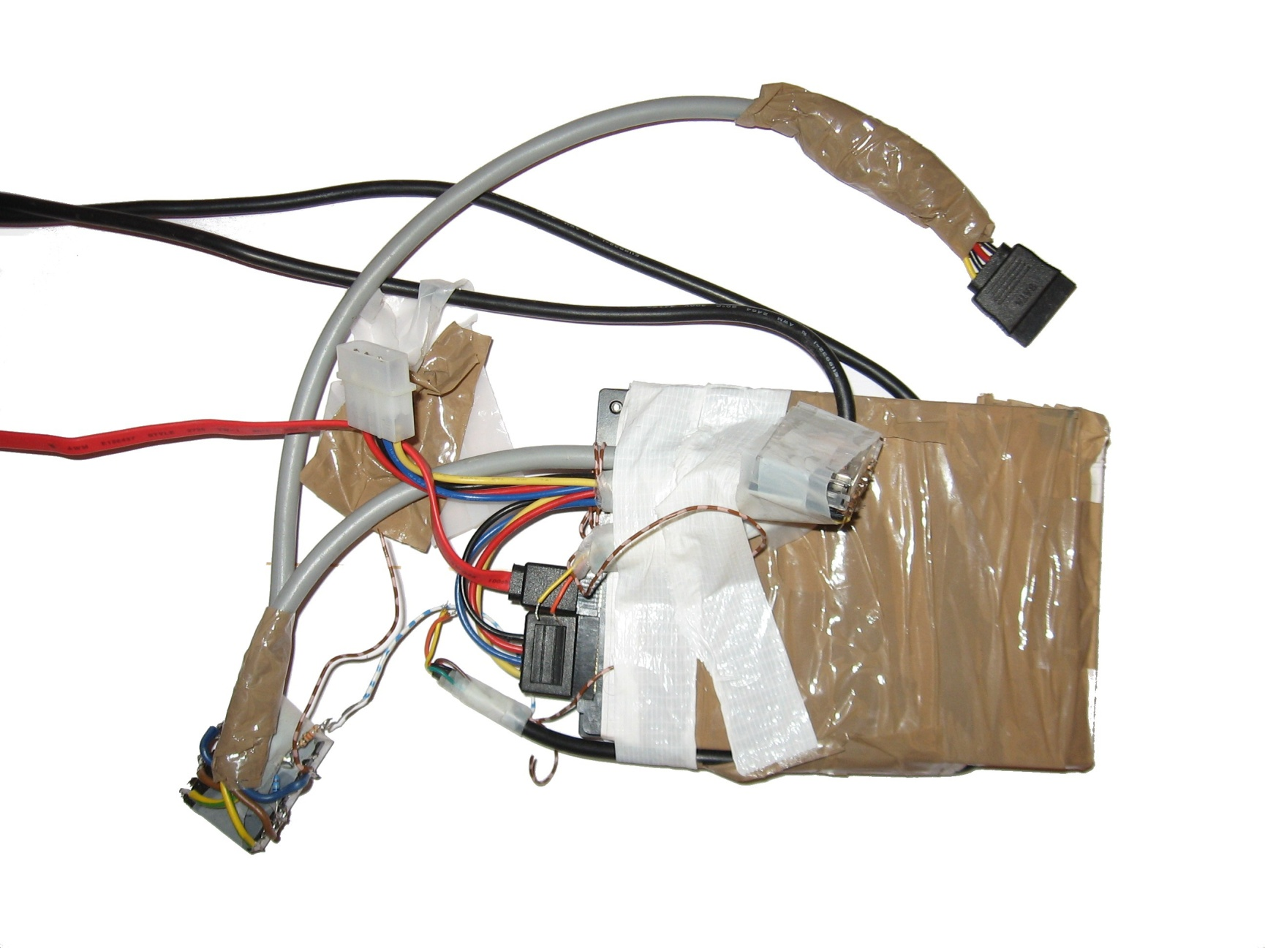
Instrumented drive
Serial console
SATA cable
SW controlled
relay
Power

Slide 13
Backdoor Implementation
Many technical difficulties...
  Custom, event based OS
  Large statically linked code, no symbols
Results:
  Backdoor inserted in a firmware update
  Intercepts disk writes
  Can read blocks from disk (unstable*)
  No significant overhead (1%)

Slide 14



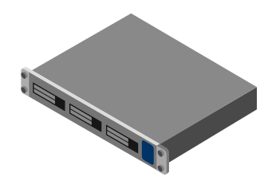
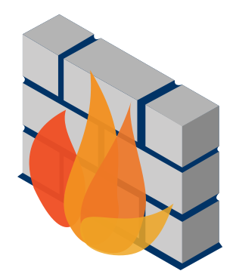


Exfiltration exemple: an online forum
Backdoor installed:
While shipping the disk
By malware
…
Web data
User data stored comments
System data (passwords)
Web forum comments

Slide 15
Initial idea
One block
M|C|?|...|?
M|C|?|?|?|?
HDR
M|C|?|?|?|?
Alignment issue

Slide 16
Improvement
One block
M|C|?|?|?|?|
M|C|?|?|?|?
Block 1
Block 2
HDR
M|C|?|?|?|?|
M|C|?|?|?|?
One full safely replaceable block

Slide 17
Exfiltration block format
One block
M|C|M|M|M|M|
M|C|M|M|M|M
Block 1
Block 2
HDR
M|C|M|M|M|M|
M|C|M|M|M|M
Fast check + no false-positives

Slide 18


M|C|M|M|EXFIL. DATA|M|M
HDR
M|C|M|M|EXFIL. DATA|M|M
HDR|M|C|M|M
EXFIL. DATA
HDR
M|C|M|M|M|M|M|C|M|M|M|M
M|M|...
HDR|M|C|M|M
M|M|M|C|M|M
M|M|...
M|C|M|M|M|M|M|C|M|M|M|M

Slide 19
Example: Exfiltrating a sensitive file
Use HDD as remote block device
  We can request any block
  So we can “mount” partitions
Exfiltrate /etc/shadow in nine “queries”:
  First retrieve partition table in MBR
  Then superblock of ext3 partition
  …
Total time: < 1 minute

Slide 20
In summary
We reverse engineered and backdoored a COTS drive
  10 person-month effort
  Without any privileged information
  No significant performance overhead
Data-exfiltration backdoor
  No cooperation from host
  Stealthy
So is this a realistic threat model after all ?
  IRATEMONK

Slide 21
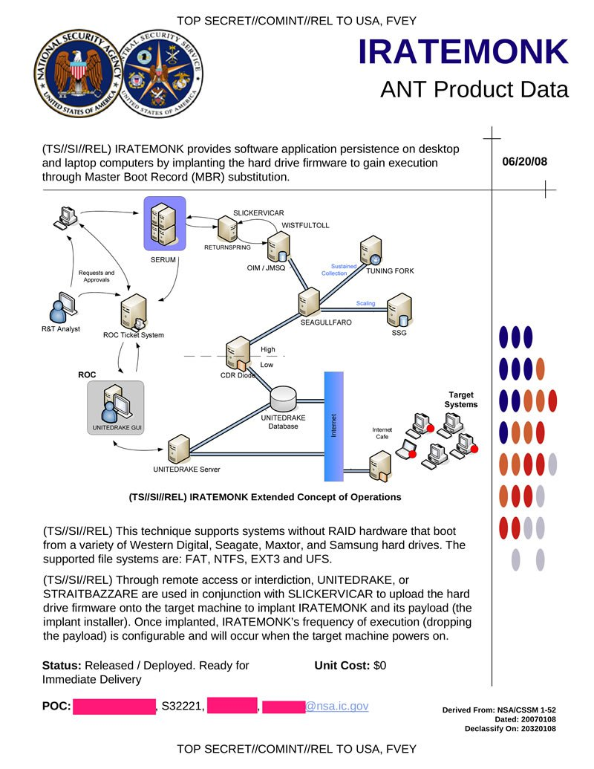
IRATEMONK ?

Slide 22
IRATEMONK ?

Slide 23
IRATEMONK ?

Slide 24
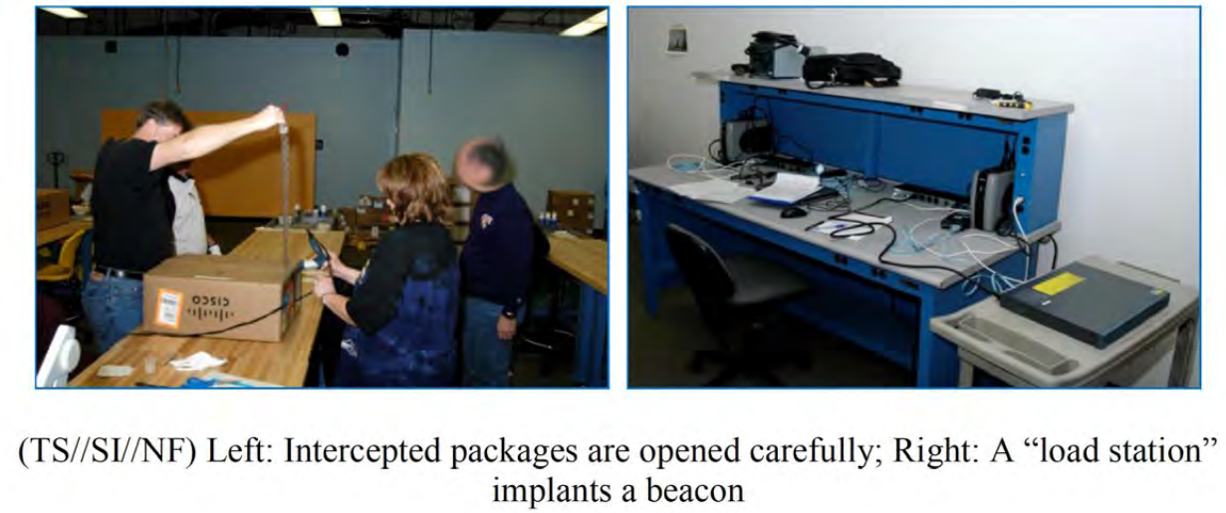
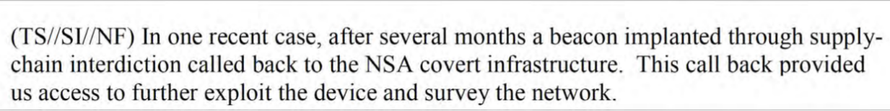
Snowden documents on “interdiction”

Slide 25
Lesson learnt
We need to trust all those embedded devices…
  But we can’t!
Performing security analysis of embedded systems is very challenging !
  Very hard to analyze the disk
  Static v/s Dynamic analysis
We need to develop new methodologies and tools for dynamic security analysis of embedded systems

Slide 26
Overview
Introduction
An attack example
A view of the state of embedded devices
Avatar
SMART
Concluding remarks

Slide 27
To appear at USENIX Security 2014
With A. Costin, J. Zaddach, D. Balzarotti
Firmware.re
A large scale analysis of embedded systems firmwares

Slide 28
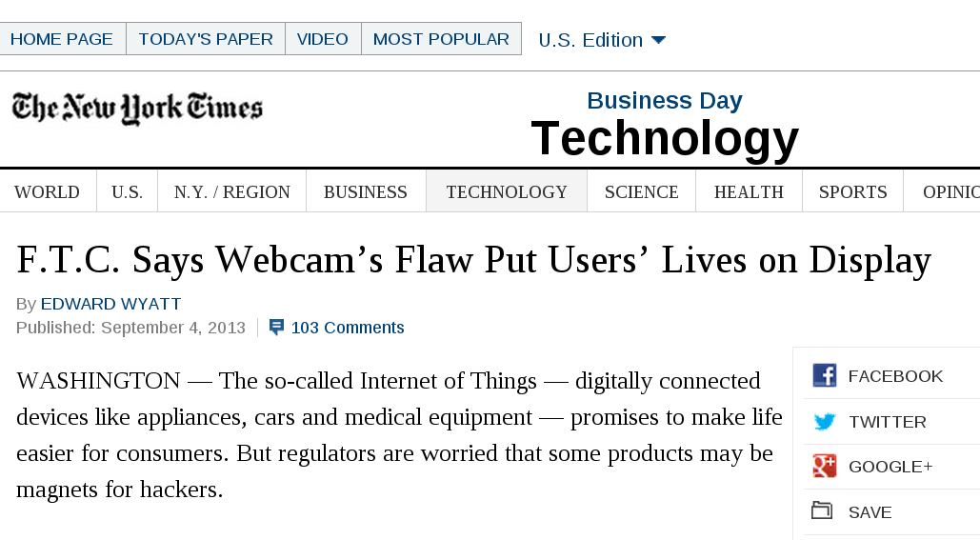
State of embedded system security
There are many secure embedded devices, smartcards, etc…

Slide 29
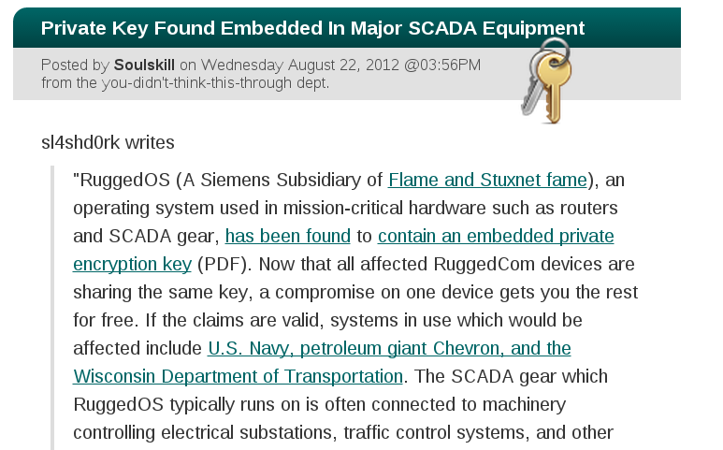
State of embedded system security

Slide 30
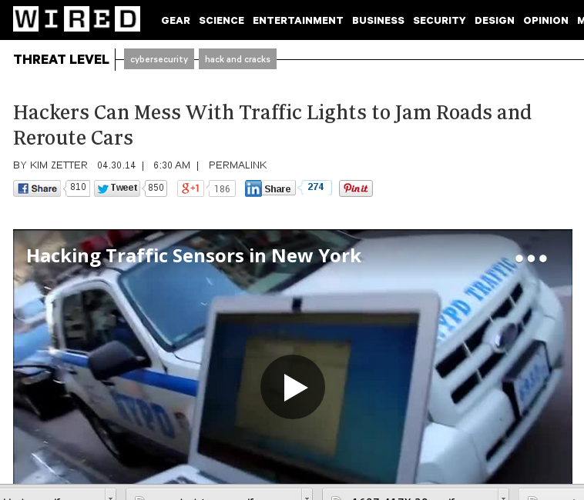
State of embedded system security

Slide 31
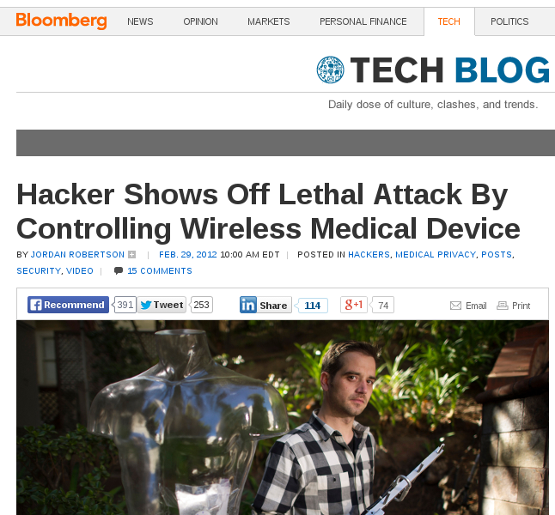
State of embedded system security

Slide 32
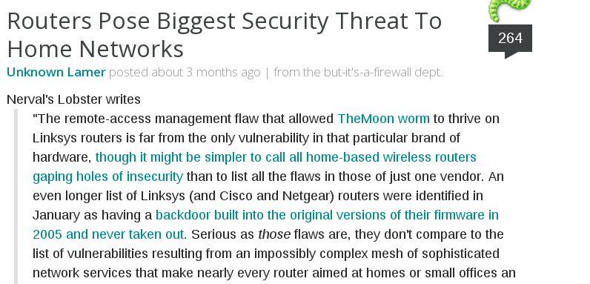
State of embedded system security

Slide 33
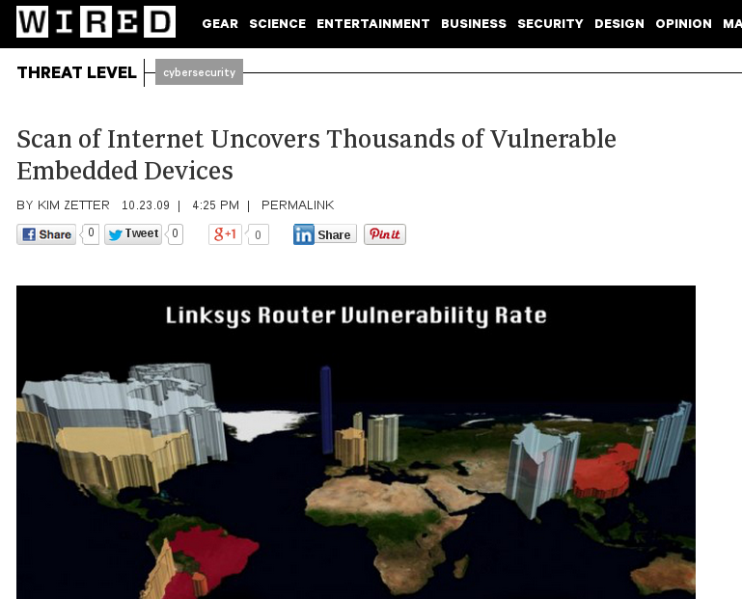
State of embedded system security

Slide 34
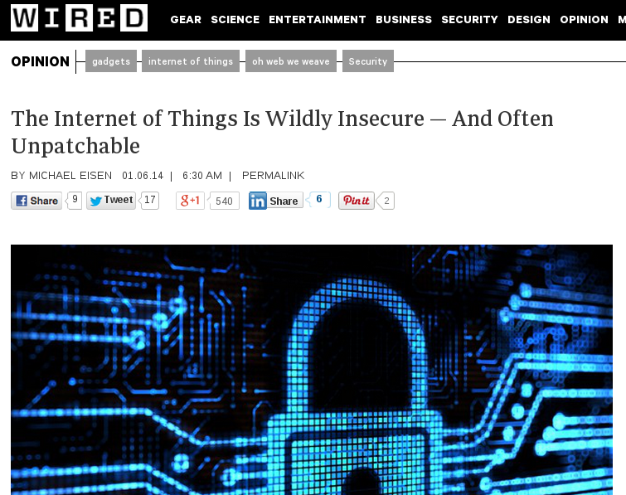
State of embedded system security

Slide 35
How to get a better idea of this ?
There are many reports of insecure embedded devices
This is just a few black sheep?
or if this this is widespread?
To (try to) answer this we need a large scale analysis

Slide 36
Approaches for such a large scale analysis
Scanning Internet for vulnerable devices
Gives good results, but
Mostly finds devices already known to be vulnerable
Cannot ethically test them actively
Testing devices in lab or manually analyzing devices
Difficult and does not scale (cost/time…)
We chose to perform a static analysis, scales well

Slide 37
Choices and challenges
To start giving answers to those questions we
Collected firmware images online
  No central place, many file formats, unknown formats
Unpacked them
  Every manufacturer seem to have his own packing method…
Analyzed them individually
  This is 1.7 Million unpacked files …
Correlated them
  With fuzzy hashes (slow), shared resources …
  complete correlation would be extremely time consuming (1.7M^2)

Slide 38
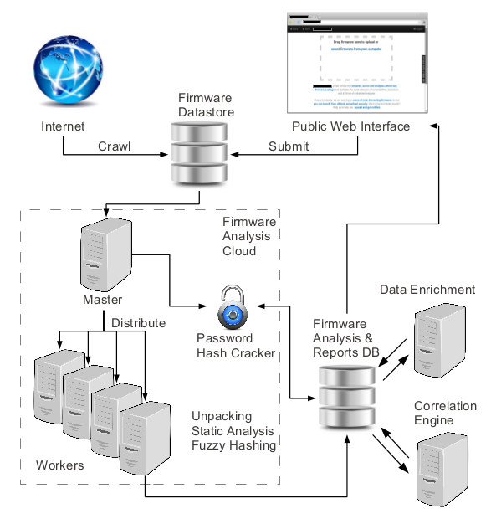
Overview

Slide 39
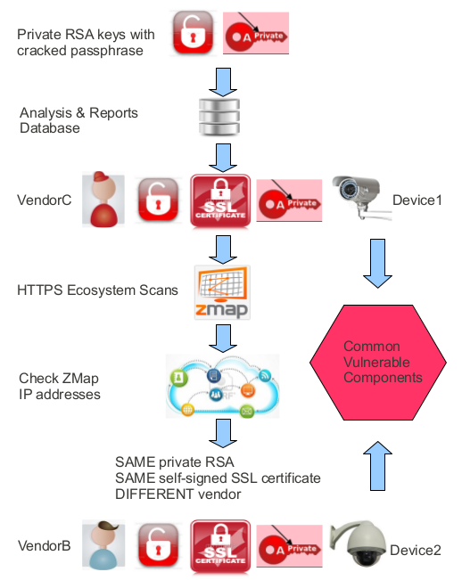
Example result
Correlation also possible
with fuzzy hashes

Slide 40
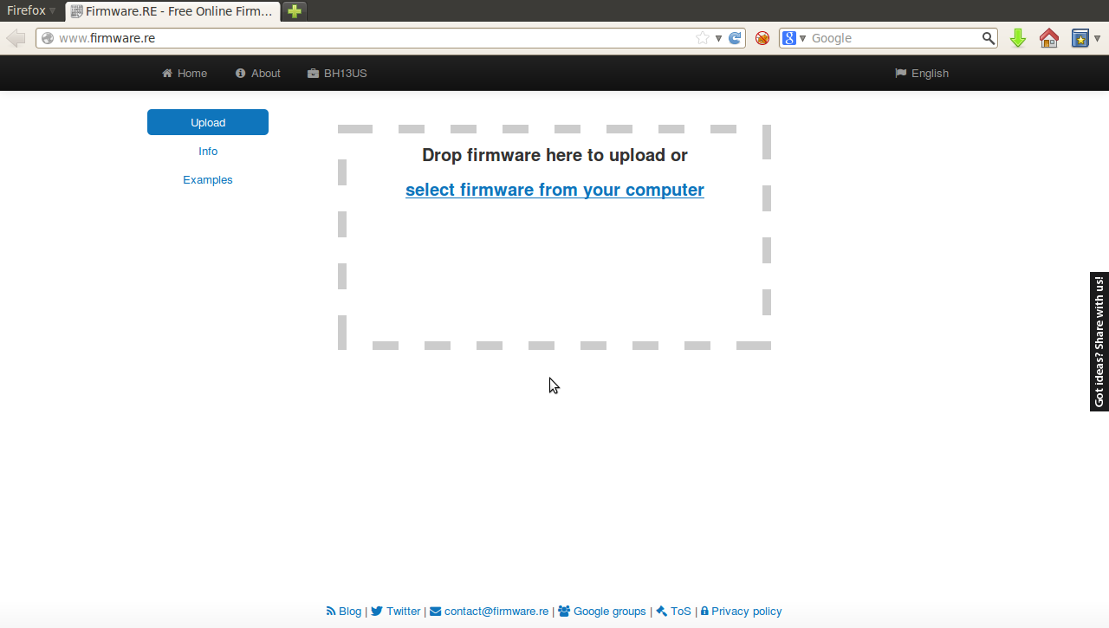
Firmware.re: unpacking as a service

Slide 41
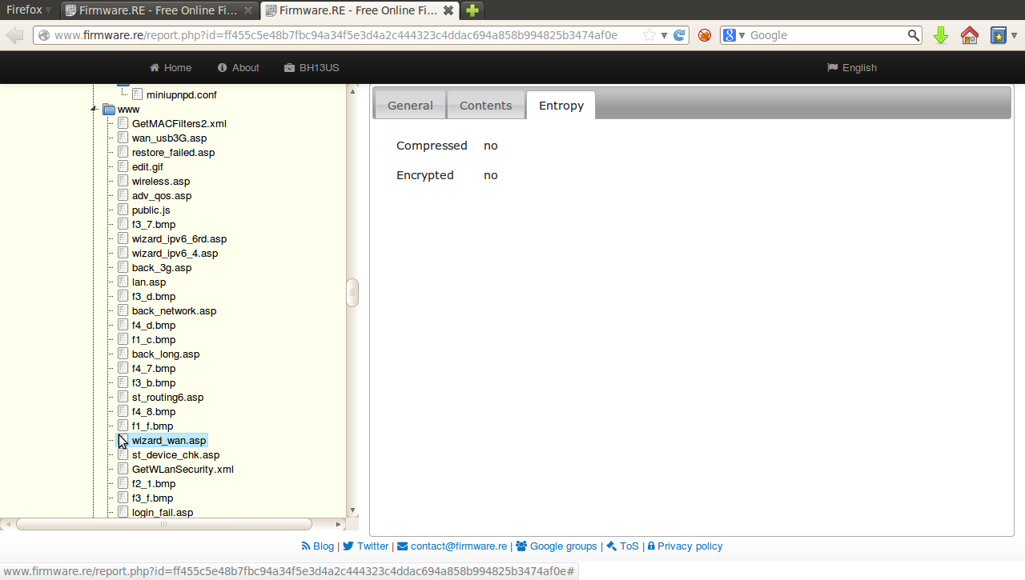
Firmware.re: unpacking as a service

Slide 42
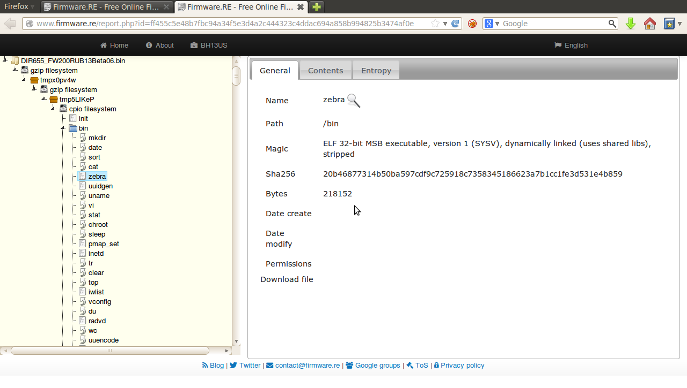
Firmware.re: unpacking as a service

Slide 43
In conclusion
Clear benefits of performing a large scale analysis
We collected 170K firmware images
  Analyzed 35000 so far
  Unpacked this to 1.7M files
Found 38 new vulnerabilities
  Affecting ~700 firmware images
  Some previously known for other devices / Brands
  Found 140 000 devices vulnerable online
Firmware.re
  Unpacking/analysis as a service
  Will be publicly available early July

Slide 44
Overview
Introduction
  Context, embedded systems security
An attack example
  A Hard Disk backdoor
A view of the state of embedded devices
Avatar
  A better method to analyze such systems
SMART
  Status of a proactive solution
Concluding remarks

Slide 45


AVATAR: A Framework for Dynamic Security Analysis of Embedded Systems’ Firmwares
NDSS ‘14
Jonas Zaddach,
Luca Bruno, Aurélien Francillon, Davide Balzarotti

Slide 46
Need for third party security evaluation
Preventive
  Evaluate 3rd party supplied products
Continuous
  Monitor infrastructure to detect regressions
  Perform security assessments mandated by law or process
Post-mortem
  Analyze failures of infrastructure in retrospect
    After an intrusion
    Look for an inserted backdoor ?

Slide 47
Challenges in security evaluation
No source code available
No toolchain available
No documentation available
Different tools for each manufacturer
  e.g., to flash and debug

Slide 48
Wishlist for security evaluation
Techniques that are typically used on a PC
  Advanced debugging techniques
    Tracing
    Fuzzing
    Tainting
    Symbolic Execution
1
2
3
4
5
Notes:
Explain nodes

Slide 49
Wishlist for security evaluation
Techniques that are typically used on a PC
  Advanced debugging techniques
    Tracing
    Fuzzing
    Tainting
    Symbolic Execution
Trace
1: x = 4
Trace
1: x = 4
3: x = 4
Trace
1: x = 4
3: x = 4
4: x = 6
1
1
1
1
2
3
2
2
3
2
3
3
Collecting an execution trace
4
5
4
4
5
4
5
5
Notes:
- Put 1 picture for tracing, tainting and one for symbolic execution to explain

Slide 50
Wishlist for security evaluation
Techniques that are typically used on a PC
  Advanced debugging techniques
    Tracing
    Fuzzing
    Tainting
    Symbolic Execution
Testcase A
x = 4
Testcase A
x = 4
Testcase B
x = 2
1
1
B
A
2
2
3
3
Testing with random input
4
4
5
5
Notes:
- Put 1 picture for tracing, tainting and one for symbolic execution to explain

Slide 51
Wishlist for security evaluation
Techniques that are typically used on a PC
  Advanced debugging techniques
    Tracing
    Fuzzing
    Tainting
    Symbolic Execution
Y=X+Y
Z=23
X=<input>
Y=0
Z=0
1
2
3
Data flow tracking
X
Y
Z
4
5
tainted
Notes:
- Put 1 picture for tracing, tainting and one for symbolic execution to explain

Slide 52
Wishlist for security evaluation
Techniques that are typically used on a PC
  Advanced debugging techniques
    Tracing
    Fuzzing
    Tainting
    Symbolic Execution
X = σ
1
X ≤ 3
X > 3
2
3
Multipath exploration
X > 7
X = 2
3 < X ≤ 7
4
5
X = 4
X = 9
Notes:
- Put 1 picture for tracing, tainting and one for symbolic execution to explain

Slide 53
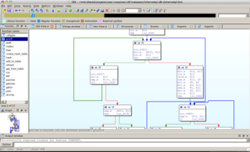

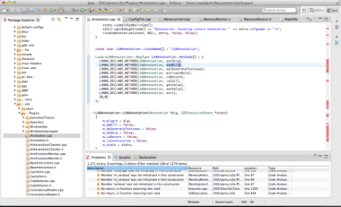

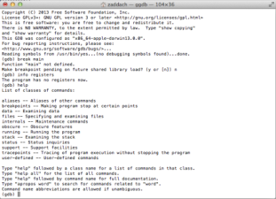

Wishlist for security evaluation
Techniques that are typically used on a PC
  Advanced debugging techniques
    Tracing
    Fuzzing
    Tainting
    Symbolic Execution
  Integrated tools
    IDA Pro
    GDB
    Eclipse
Notes:
- Put 1 picture for tracing, tainting and one for symbolic execution to explain

Slide 54
Lack of dynamic analysis techniques on embedded systems
Those techniques are mostly not available on embedded systems because
Platforms are composed of unknown/undocumented peripherals
Emulating CPU without peripherals not enough to execute firmware properly
Monitoring execution or simple debugger on real hardware often impossible/not enough

Slide 55
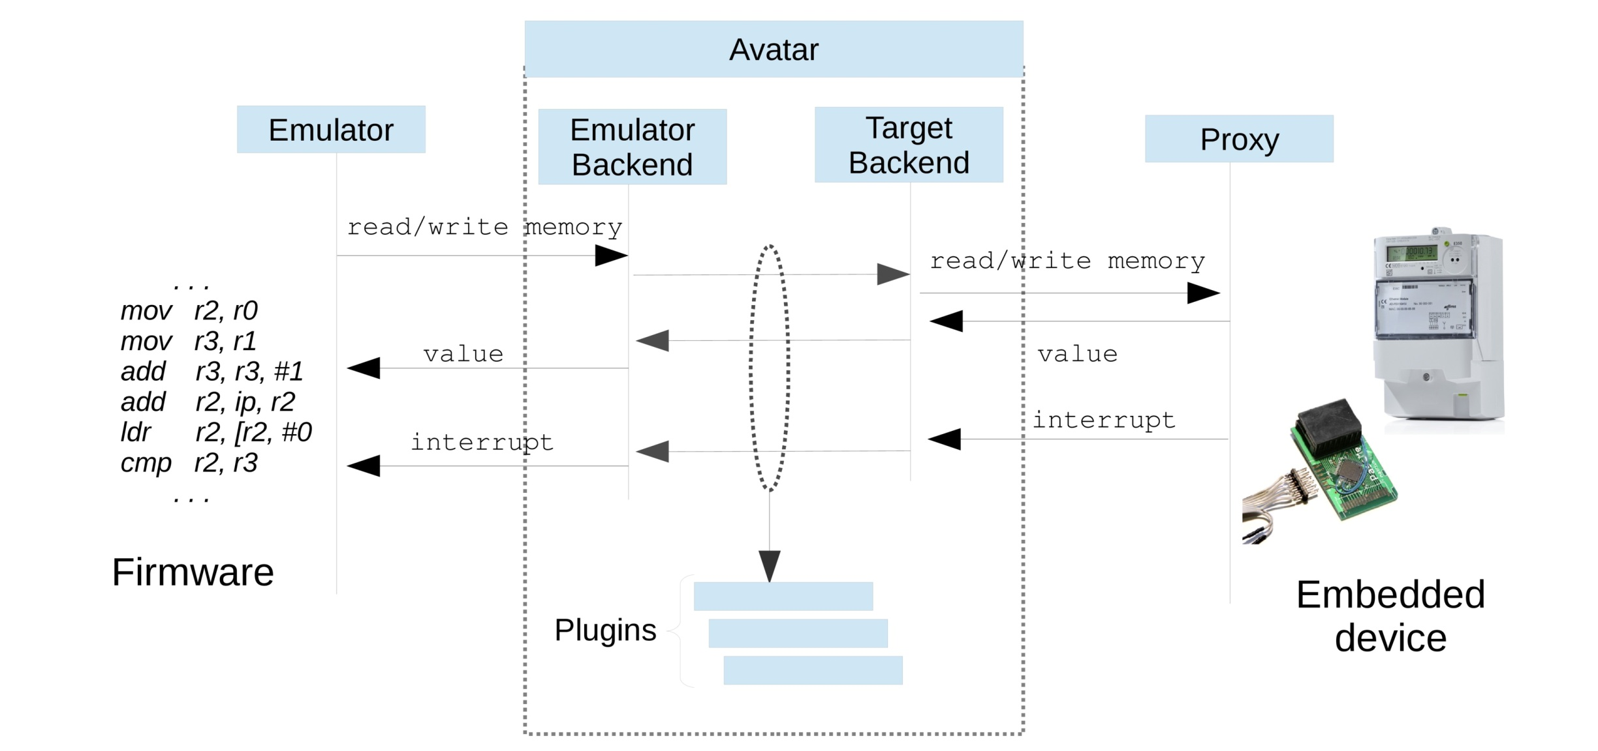
Avatar simplified principle

Slide 56
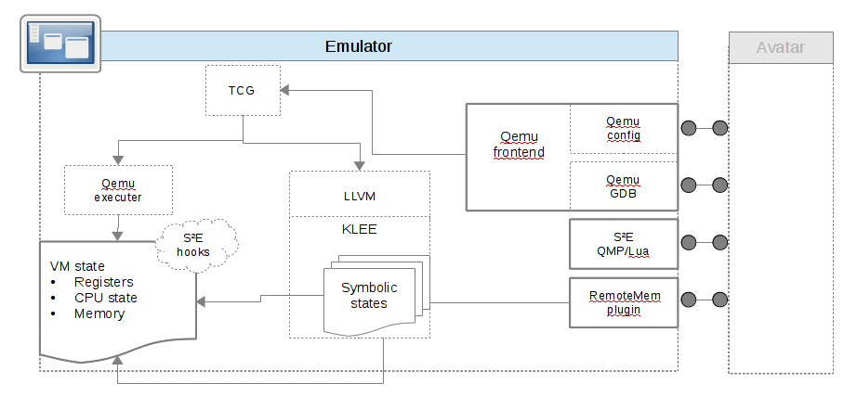
Avatar simplified principle

Slide 57
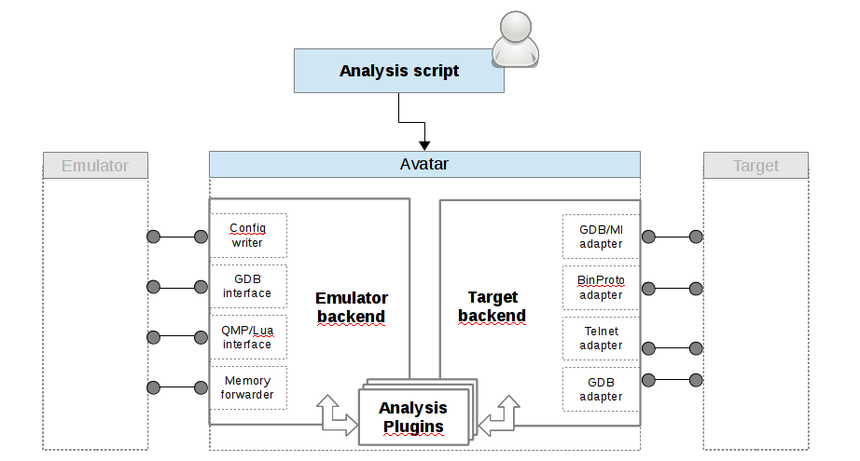
Avatar simplified principle

Slide 58
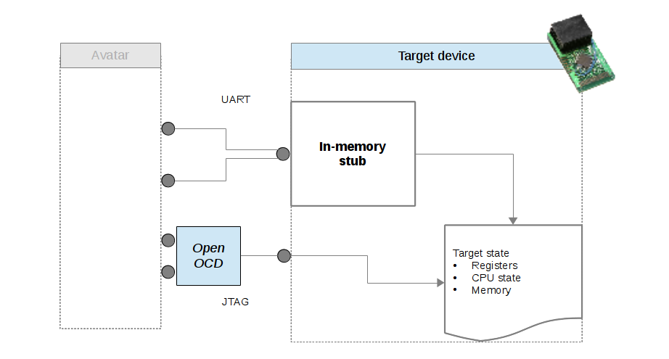
Avatar simplified principle

Slide 59
Optimizations
Basic approach is very slow
  Seconds of normal execution can become days
Forwarding only IO
  We need to know/detect IO memory vs. normal memory
Timing critical sections
  Execute some code on the device
Transfer state from/to the device
  Whole memory
Handling interrupts
  Several cases
Notes:
If you know the DMA controller, you can break after the DMA access
You can checksum memory after a suspected DMA
-Speculative memory forwarding could uncover DMA

Slide 60
Limitations
State consistency
  DMA memory changes not tracked
  Memory interactions of code migrated to the device not tracked
Timing consistency
  Emulated execution time much slower than real execution time
  Timing of external events (e.g., incoming network packets) cannot be controlled
Symbolic execution
  Symbolic values need to be concretized when leaving the emulator domain
  Optimizations of hardware access with concretized values needed
  Coherency between HW and SW
Notes:
If you know the DMA controller, you can break after the DMA access
You can checksum memory after a suspected DMA
-Speculative memory forwarding could uncover DMA

Slide 61
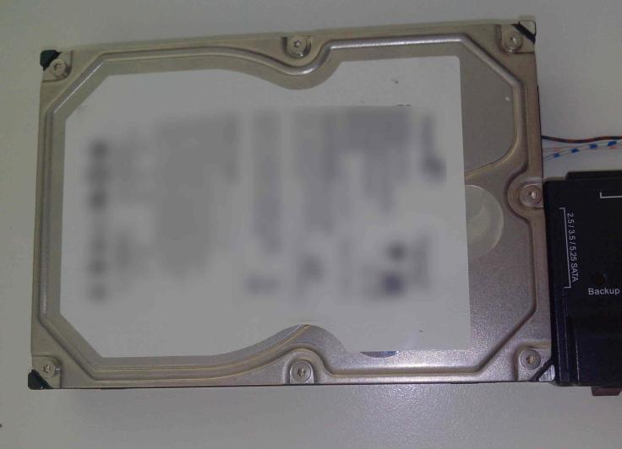
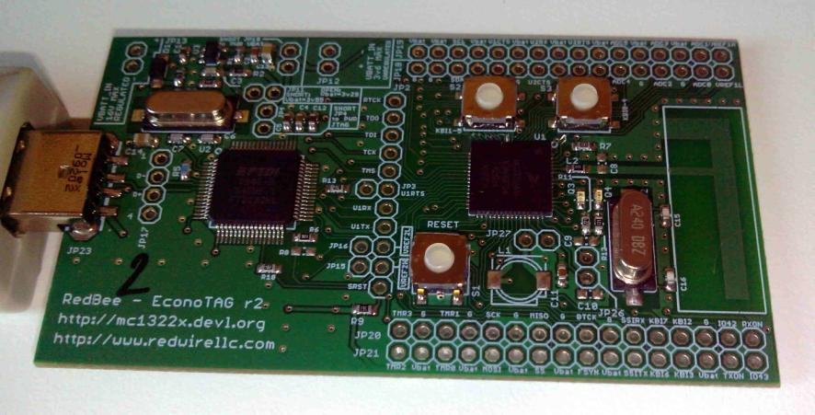
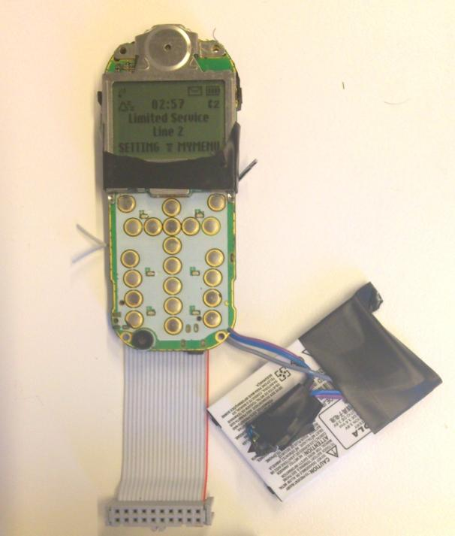
Use cases
Analyzing the ROM bootloader of an HDD
Finding bugs in a Zigbee wireless sensor device
Analyzing the baseband code of a GSM feature phone

Slide 62
GSM Phone example
GSM Phone used with
  an open source BTS (OpenBTS)
  Install Avatar with original firmware
    with JTAG debugging
Goal: Find flaws in the SMS decoding routine
Procedure
  Break after receiving SMS payload
  Clone state to emulator
  Replace SMS with symbolic values,
    execute symbolically in the emulator
  Check for symbolic values in
    program counter
    load/store address
Notes:
Break after SMS reception since phone is complex
No Bug found because of state explosion -> GSM stack complicated

Slide 63
Avatar Summary
Enables to perform some analysis that were impossible before
Is a versatile, Open Source platform
  http://www.s3.eurecom.fr/tools/avatar/
We are currently using it to analyze
  smartphones basebands
  PLCs
  …

Slide 64
Overview
Introduction
An attack example
A view of the state of embedded devices
Avatar
SMART
  Status of a proactive solution
Concluding remarks

Slide 65
Minimalistic Dynamic Root of trust and remote attestation in embedded devices
“SMART”
Joint work with:
Karim El Defrawy, Daniele Perito, Gene Tsudik (NDSS 2012)
Quan Nguyen, Kasper B. Rasmussen, Gene Tsudik (DATE 2014)

Slide 66
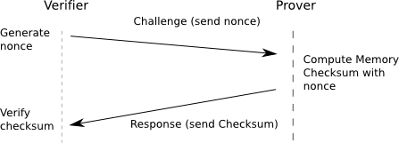
Remote Attestation
Needs guarantees that Prover is not lying!

Slide 67
Difficulty in remote attestation
How do we ensure an attacker cannot fake the result ?
  Very difficult only by software (software based attestation)
How to make this cost efficient?
  Not too intrusive ?

Slide 68

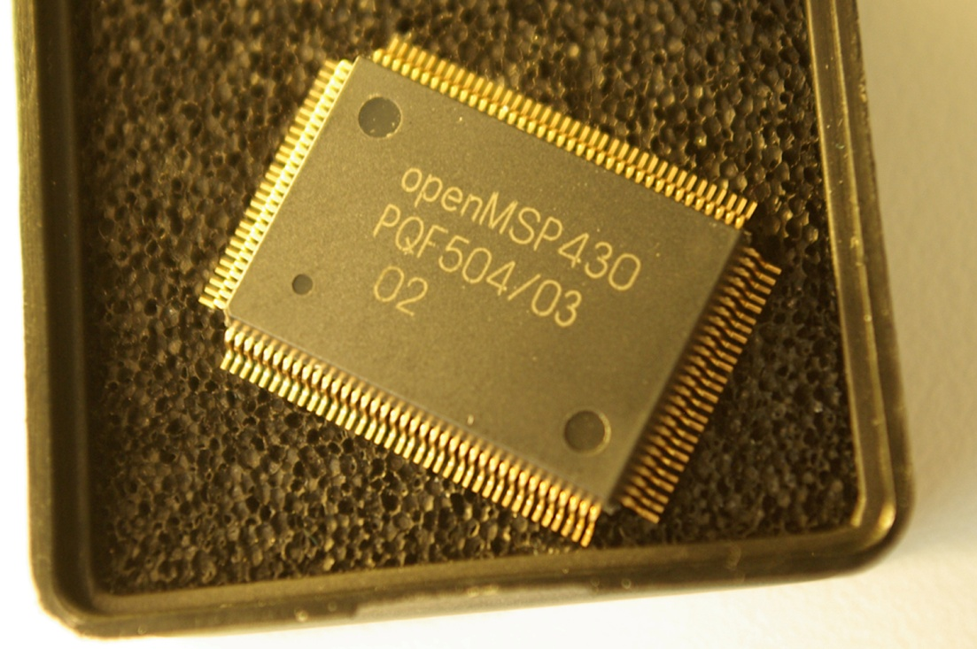
SMART Goal: providing external verification
  Device authentication
  Attestation
  Trusted Execution
With minimal modifications to a CPU Architecture
  Simple modification to the HW
  Most of the logic in software
SMART prototype
Small series chips (MPW)
Working prototype
  Interest from industry
Successful project review
Now aiming at:
  Proving properties
  Verification Techniques
Industry interests

Slide 69
To conclude
Many topics in embedded systems security
  Static analysis
  Dynamic analysis
  Root of trust, lightweight security mechanisms
The community has focused a lot on
  Important cryptographic problems (side channels…)
  Design methods, formal verification
  But systems aspects less explored
Security of such devices should now be a priority
  Not only of « security devices »
  but also of most Common Off The Shelf (COTS) devices

Slide 70
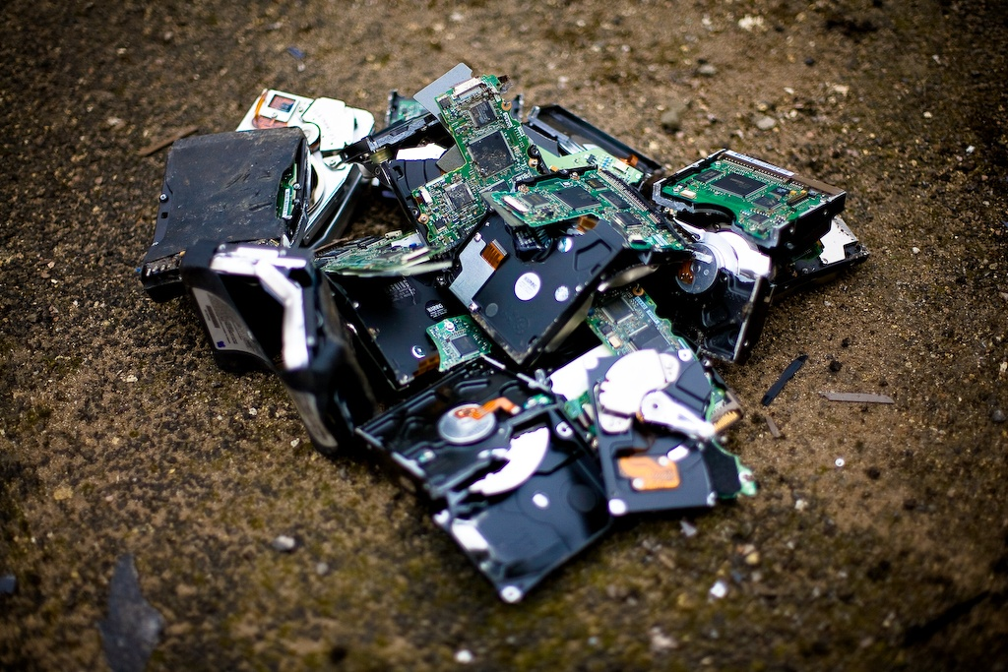

Questions?
Avatar page:
Kind thanks are due to those devices who valiantly gave their lives toward scientific investigation and research.

