Slide 1

Security Issues and Directions of Intelligent Transport Systems within limited-resources constraints
Dr. Azzam Mourad
Assistant Professor
Department of Computer Science and Mathematics
Lebanese American University (LAU)

Slide 2
Research Interest
Information Security
Security Hardening
Web Services Security
MANET/VANET Security
Trust in Web Services
Mobile Cloud

Slide 3
Outline
Project Overview
Security of Composite Services
  AspectBPEL
  SBA-XACML
Selfish Node Detection in VANET
  Efficient Clustering Model
  Cooperative Detection Model

Slide 4
Intelligent Transport Systems
Contribute in solving several daily life problems
    Control real-time traffic
    Manage incident
    Reduce the environment pollution
    Reduce time Delay → Reduce Financial Loss
    Reduce Energy/Gaz Consumption
    Boost the productivity and expand economic growth
Lack of ITS infrastructure in developing countries
    Lead to lack of information for intelligent decisions
    Need to provide alternative solutions based on
      Multiple and diverse source of information
      Avoiding the costly infrastructure sources
Interest of advanced country is in reducing the high cost of infrastructure maintenance and upgrades

Slide 5
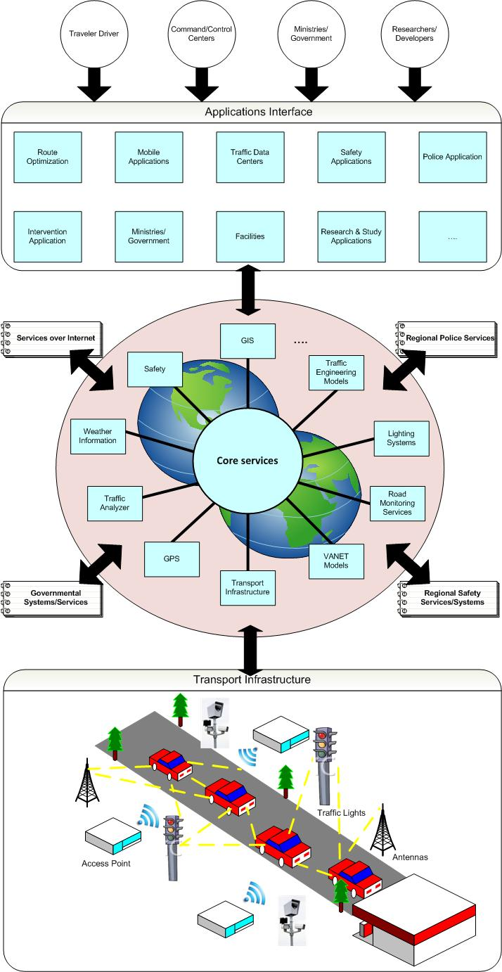
Project Overview
Challenges
  Services Composition
  Adaptability and Cooperation
  Context-awareness
  QoS
  Security, Trust and Privacy
  Models and Algorithms for Traffic Management and Intelligent Decision Modules

Slide 6
Partners and Collaborators
Lebanon
    CNRS Lebanon
    Lebanese American University (LAU)
    Lebanese University
    Private Sectors
France
    LIMOS
Canada
    Concordia University
    ETS Montreal
UAE
    Khalifa University
Looking for other international partners

Slide 7
Outline
Project Overview
Security of Composite Services
  AspectBPEL
  SBA-XACML
Selfish Node Detection in VANET
  Efficient Clustering Model
  Cooperative Detection Model

Slide 8
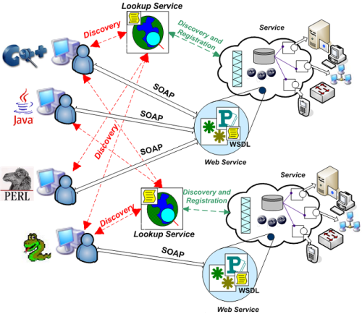
Introduction
Motivations
WSs are emerging as convenient mechanism for automated interaction between distributed applications

Slide 9




Introduction
Motivations
Web Service
Nevertheless, the successful deployment of this technology cannot hide the security breaches
and threats that Web services can be exposed to.

Slide 10
Introduction
Motivations
Web Service
SAML
WS-Security
…
SAML , WS-Security and other standard security languages emerged to offer message-
level security for web services.

Slide 11
Introduction
Motivations
Web Service
SAML
WS-Security
…
Web Service
Web Service
However, the problem arises when several distributed and/or independent Web services are
composed together in a process to form a complex system.

Slide 12
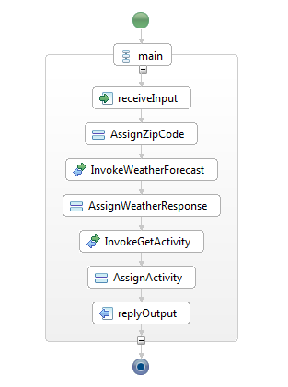

BPEL Example: Weather Forecast Process
1- SOAP Request: GetActivity/Weather Parameter : 12345
2- SOAP Request: GetWeatherInfo, Parameter : 12345
Web Service
3- SOAP Response : Rainy
6- SOAP Response: Shopping
4- SOAP Request: Rainy
Web Service
5- SOAP Response: Shopping

Slide 13
BPEL Example: WS-Security
<soap:Envelope
<soap:Header>
<wsse:Security>
<xenc:EncryptionMethod Algorithm = "http://www.w3.org/2001/04/xmlenc#tripledes-cbc" />
</wsse:Security>
</soap:Header>
<soap:Body>
<xenc:CipherData>
<xenc:CipherValue > InmSSXQcBV5UiT </xenc:CipherValue>
</xenc:CipherData>
</soap:Body>
</soap:Envelope>
1- Where can I find a weather forecast service?
UDDI
2- There is a “Weather Service” in Server B
3- How exactly should I invoke you?
Web Service
4- Take a look at this WSDL
5- WSS SOAP Request
6- SOAP Response: Rainy

Slide 14

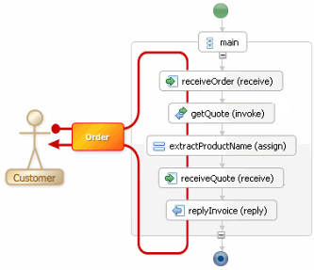

Problem 1
SAML
WSS
Performance Issue !
…
Need for centralization !
SAML
WSS
…
SAML
WSS
…
BPEL is only given the
responsibility of business modeling.
Message-level security at each
individual web service.

Slide 15
Problem 1
Possible solution may be to harden the security of a BPEL process
to embed the security verification code within the business logic of
such process.
With the use of the current BPEL:
  There is a lack of modularity for modeling cross-cutting concerns : Security, Logging, monitoring, etc…
  No support at the process deployment level for changing the
  composition at run time. Thus, deactivation of the process upon modification.
  Centralization of security at the web service side, which causes a lot of overhead.

Slide 16
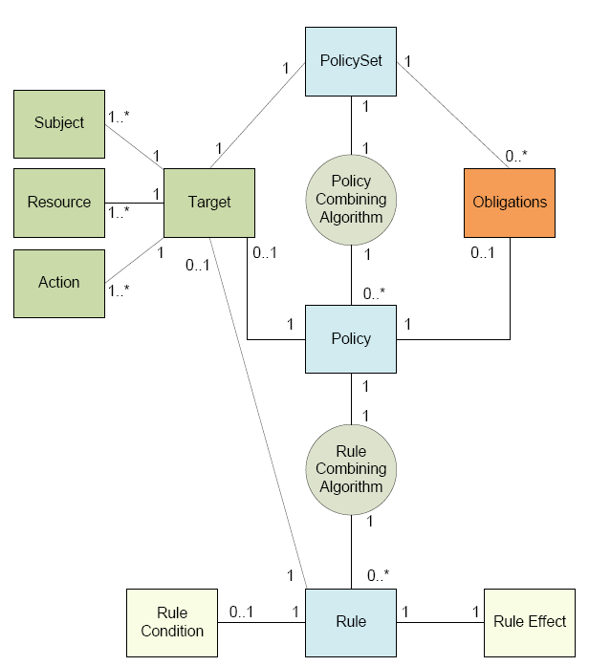
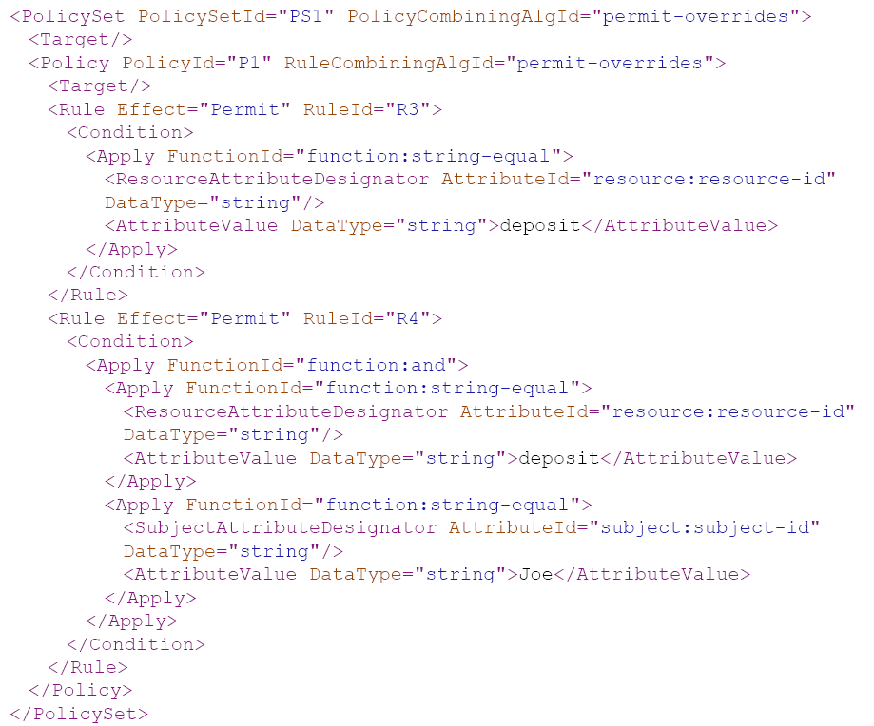
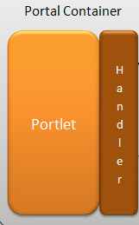
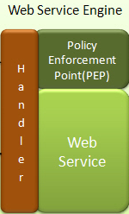


Problem 2
Another more dynamic approaches may be to enforce security
through policy languages like WSPL and XACML.
XACML

Slide 17
Problem2
Large and complex policies lead to slower access request/response time.
Specifying security policies using these languages is difficult, error-prone and time consuming.
Hidden conflicts that may arise due to the diversity of roles in policies that are difficult to locate and resolve.
No verification processes to ensure policy correctness
  Difficult to analyze and detect flawed policies due to complex structure.
  Multiple XACML party integration is very difficult.
Usually they are enforced at the WS level

Slide 18
1- AspectBPEL: Dynamic Weaving based on Aspect-Oriented Programming
Weaver

Slide 19
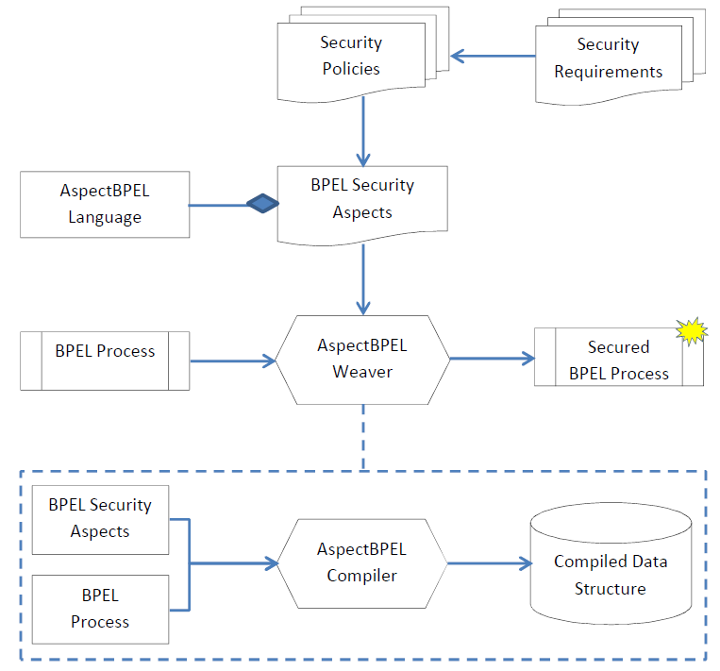
1- AspectBPEL: Dynamic Weaving based on Aspect-Oriented Programming

Slide 20

1- AspectBPEL Limitations
AspectBPEL can solve the modularity and the security problems in the Web
services composition but…
Complex Policies
Adaptability
Conflict
Moreover, the work in which AspectBPEL is presented does not provide
any methodology for verification before and after weaving
Correctness
Deadlock-Free
Original Behavior Maintainability

Slide 21
1- Extended AspectBPEL
Aspect aspect_name //Begin a New Aspect
BeginAspect
    Before | After | Replace //Insertion Point
      Activity_Type <activity_name> //Location Identifier
    BeginBehavior
    ....Behaviorcode //Code to Add
    EndBehavior
  EndAspect
Priority priority_value
Variable1 operator variable1_value connector Variable2 operator variable2_value …
Activation_Condition activation_condition_value

Slide 22
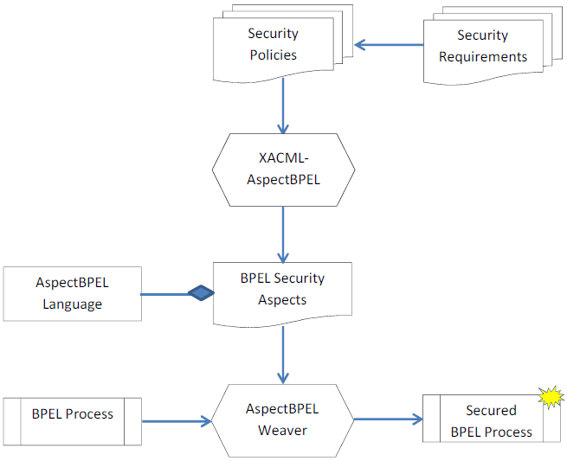
1- Extended AspectBPEL

Slide 23
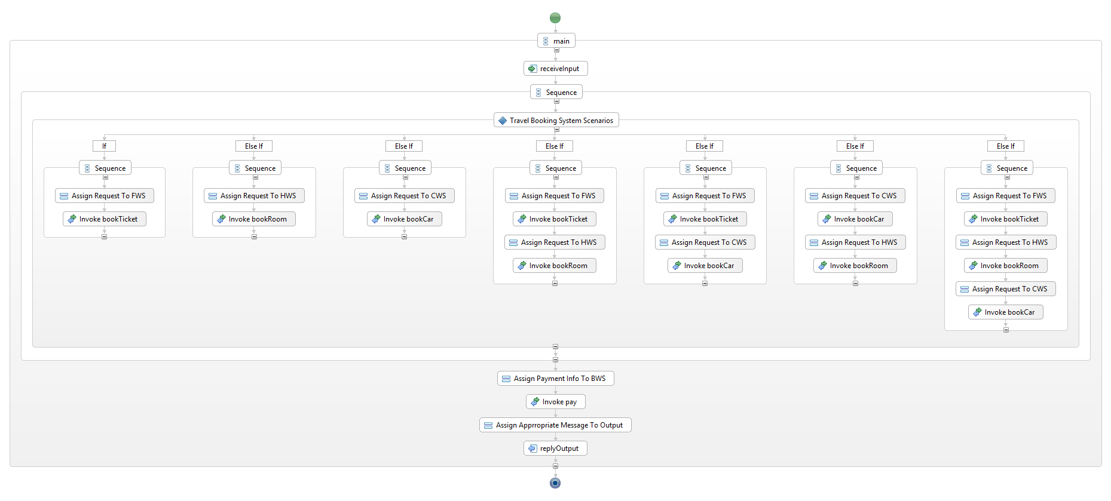
1- Case Study

Slide 24
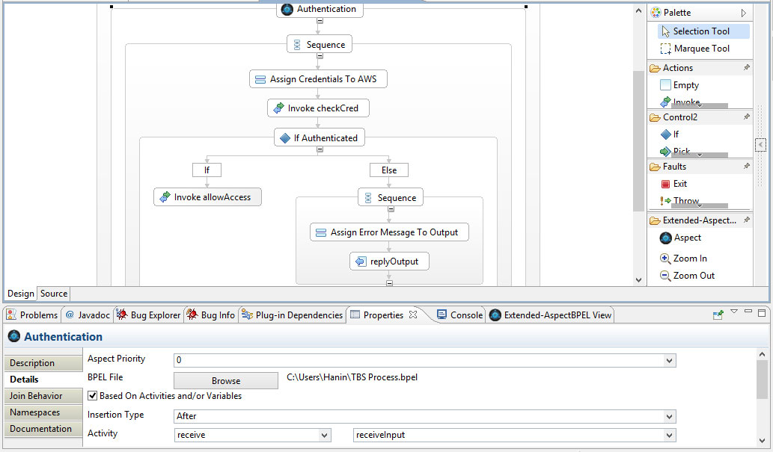
1- Case Study

Slide 25
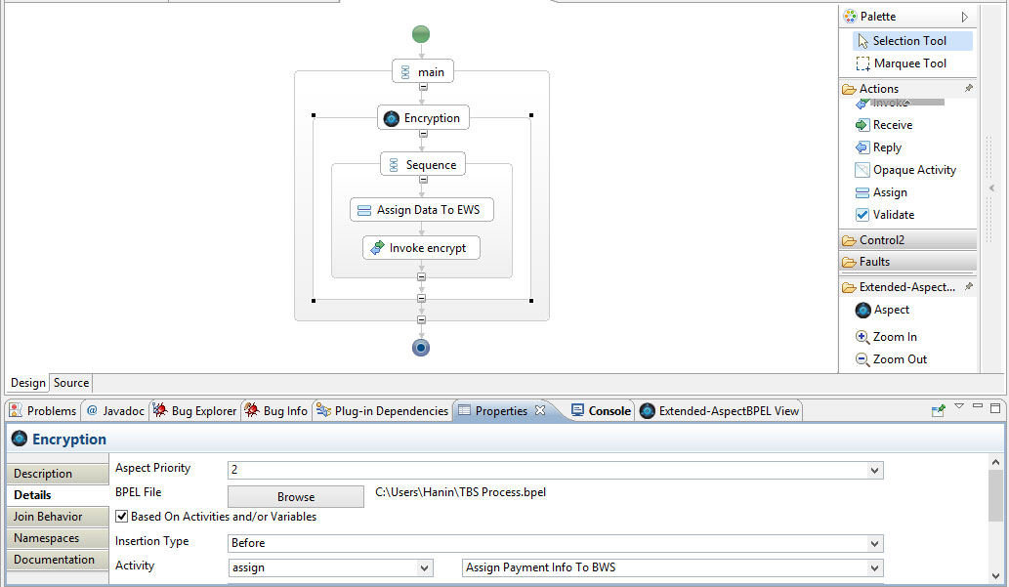
1- Case Study

Slide 26
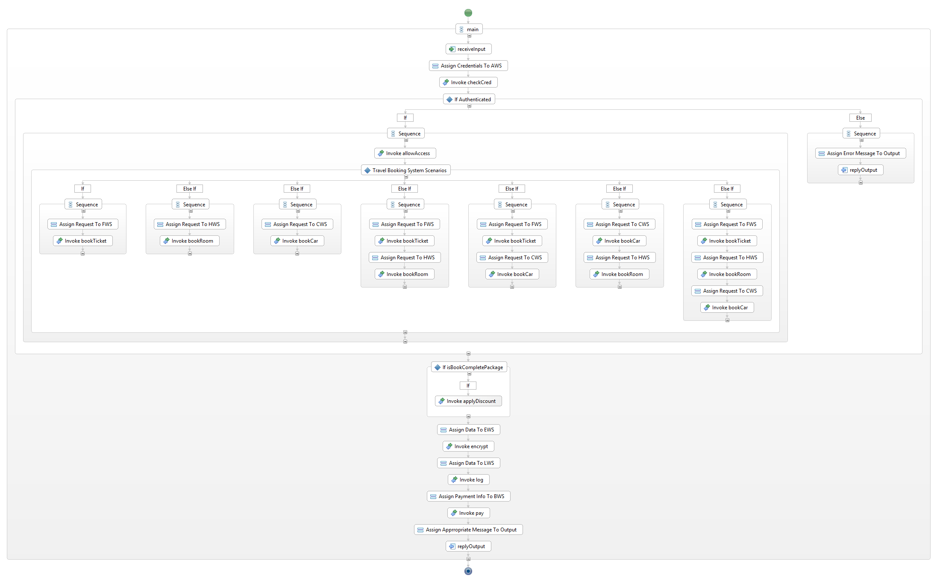
1- Case Study
Authentication “After” “receiveInput”
Only Authenticated users can get access to TBS services
Just in case the user books a complete package, the Discount will be applied
Encryption precedes Logging
Discount, Encryption and Logging
“Before” “Assign Payment Info To BWS”

Slide 27
1- Formal Verification Mechanism on BPEL
BPEL
Process
BPEL2-OWFN
Tool
PNML
File
TINA
Tool
Ktz
File
LTL
Property
Result
Original Behavior
Maintainability
Deadlock-Free
Correctness

Slide 28
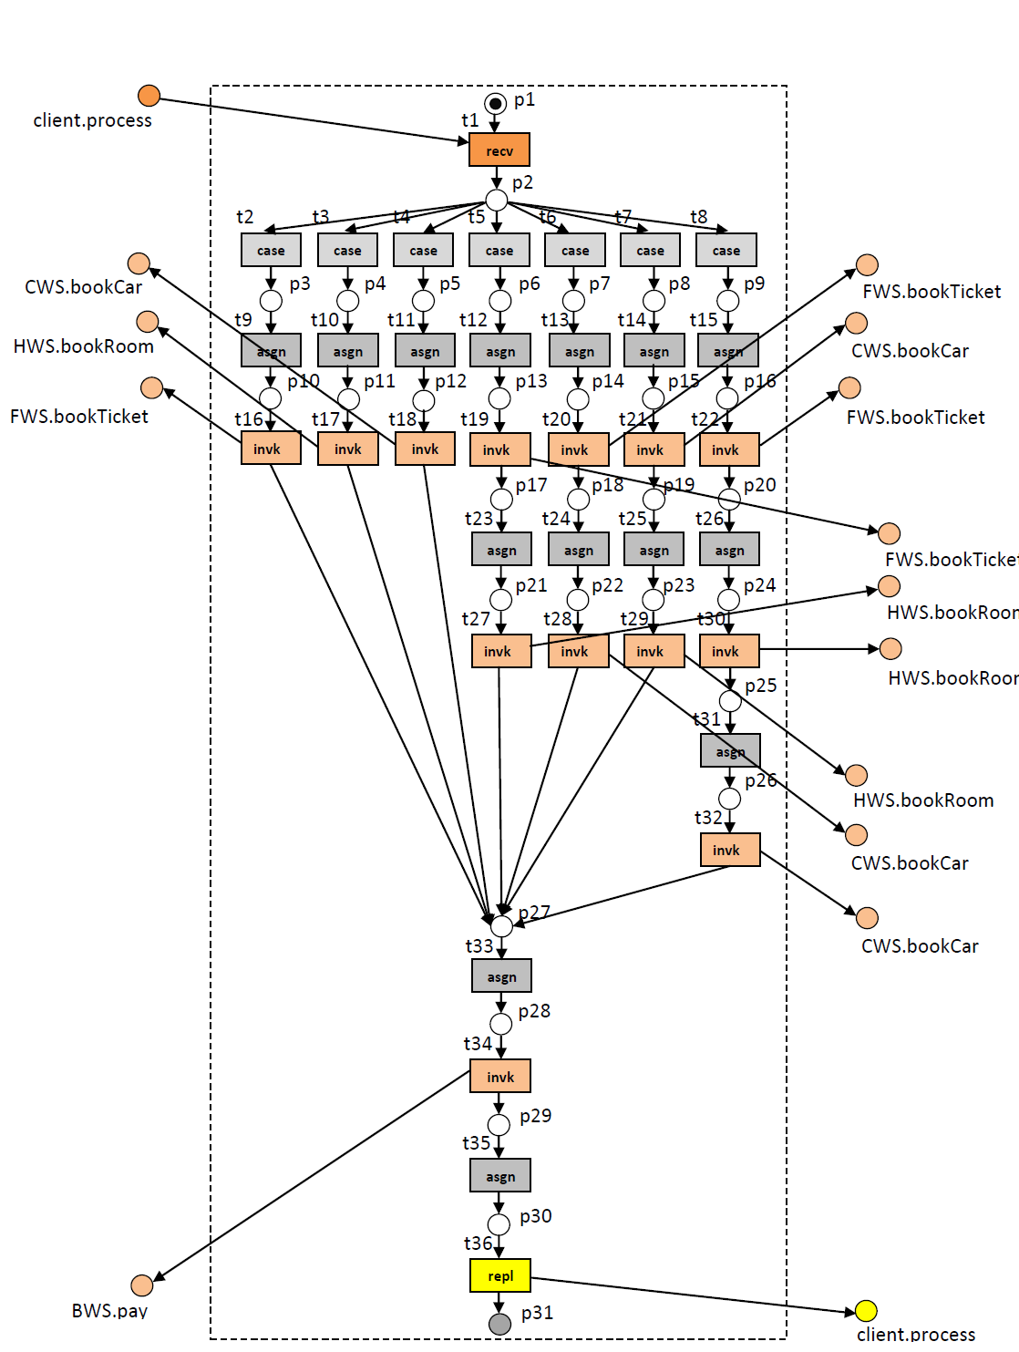
1- Formal Verification Mechanism on BPEL

Slide 29
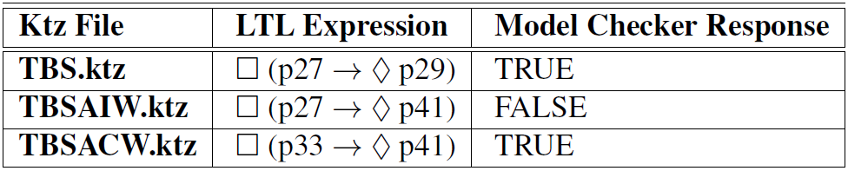
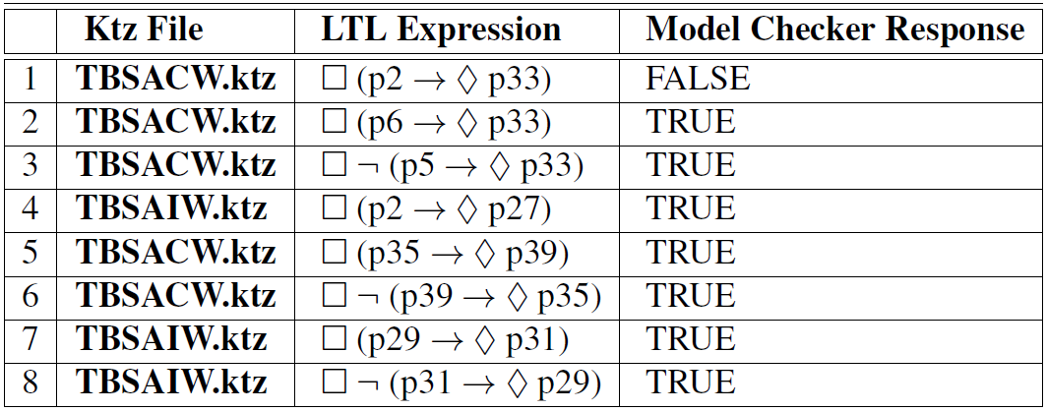
1- Formal Verification Mechanism on BPEL
Table-1 Original Functionalities Maintainability Verification
Table-2 Deadlock-Free Verification
Table-3 Correctness Verification
In the next state |
Always in the future |
Eventually |
Alternative of OR |
Logical implication

Slide 30
2- SBA-XACML Evaluation and Analysis
SBA-XACML Language
XACML Request
SBA-XACML Compiler
XACML PolicySet
SBA-XACML Request
SBA-XACML PolicySet
Policy Analysis
Module
Policy Evaluation Module
Analysis Report
Response

Slide 31
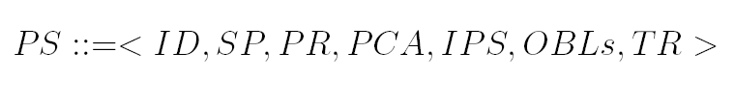
2- SBA-XACML Syntax
A PolicySet (PS) is the top element of the based policy and is mapped to set-based as:
Element | Definition
PS | PolicySet
ID | PolicySet ID
SP | Set of Policies
PR | Precedence order between policies
PCA | Policy Combining Algorithm
IPS | Policy reference
OBLs | Set of Obligations
TR | Target

Slide 32
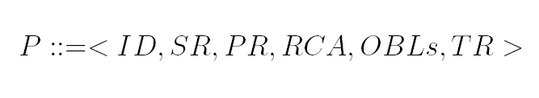
2- SBA-XACML Syntax
A Policy (P) is the middle element of the based policy and is mapped to set-based as:
Element | Definition
P | Policy Type
ID | Policy ID
SR | Set of Rules
PR | Precedence order between rules
RCA | Rule Combining Algorithm
OBLs | Set of Obligations
TR | Policy Target

Slide 33

2- SBA-XACML Syntax
A Rule (R) is the bottom element of the based policy and is mapped to set-based as:
Element | Definition
R | Type: Rule
ID | Rule ID
RC | Rule Conditions
TR | Rule Target
RE | Rule Effect

Slide 34

2- SBA-XACML Syntax
A Request (Rq) is mapped to set-based as:
Element | Definition
Rq | Type: Request
Sr | Request Subjects
Rr | Request Resources
Ar | Request Actions

Slide 35
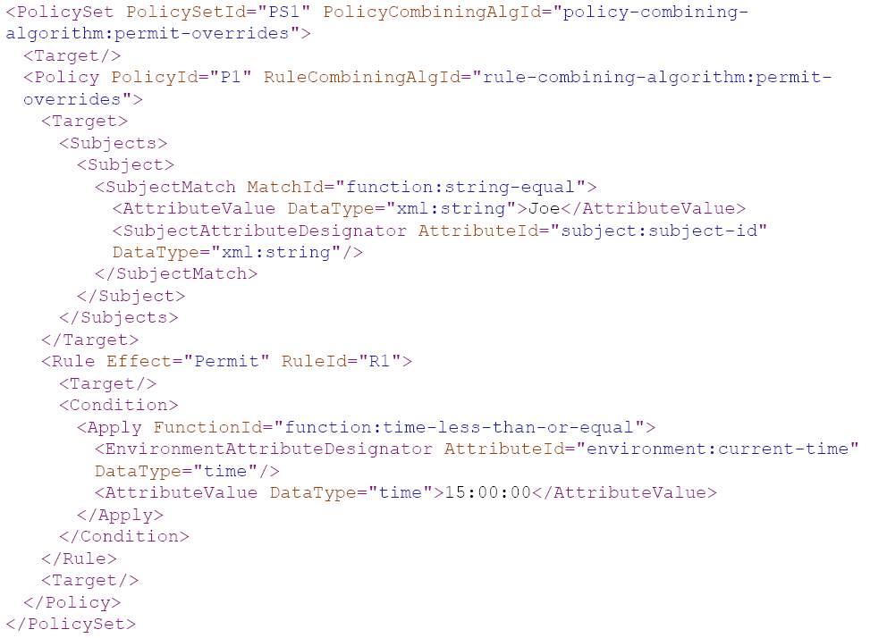
2- XACML to SBA-XACML

Slide 36
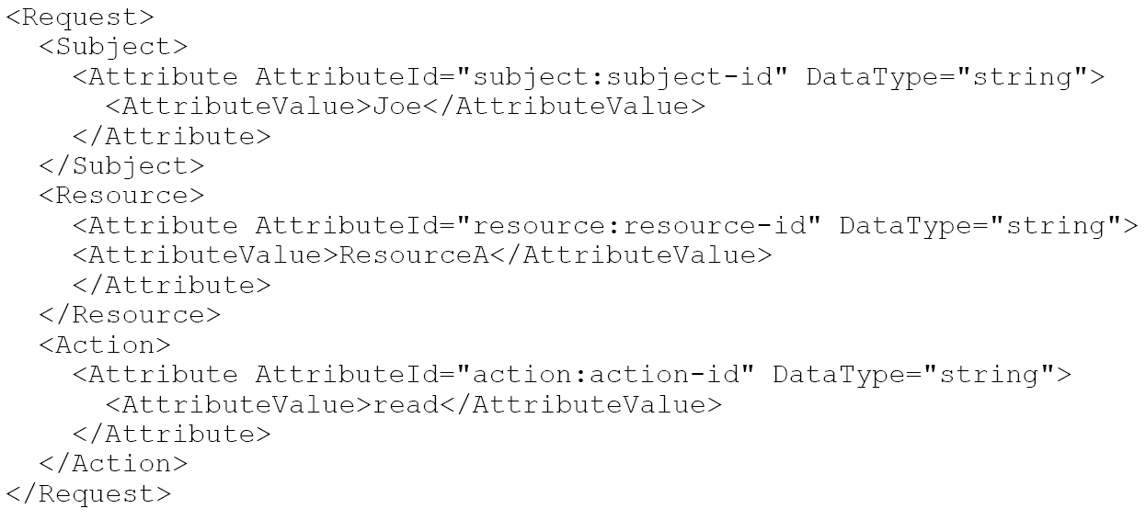

2- XACML to SBA-XACML
XACML Request:
SBA-XACML Request:

Slide 37
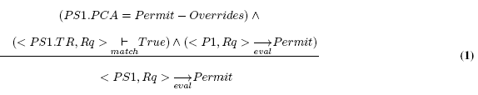

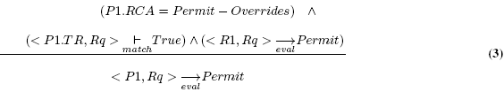

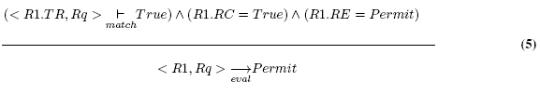

2- SBA-XACML Evaluation Semantics (27 rules)

Slide 38
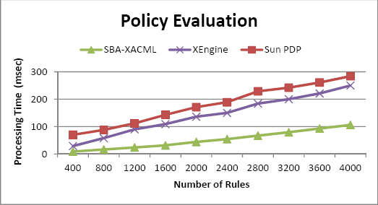
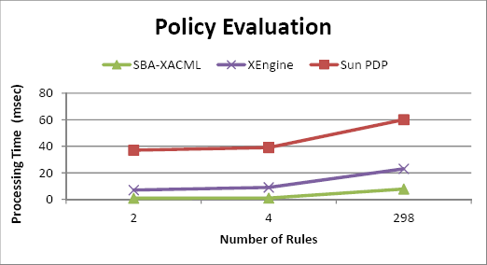
2- Experimental Results
@1600 rules | Avg. per 100k Run
Sun PDP | 143 ms
XEngine | 109 ms
SBA-XACML | 31.62 ms
SBA-XACML is 4.5 and 3.4 times more efficient than Sun PDP and XEngine respectively.
Synthetic Policy Evaluation
@298 rules | Avg. per 100k Run
Sun PDP | 60 ms
XEngine | 23 ms
SBA-XACML | 8 ms
SBA-XACML is 7.5 and 2.8 times more efficient than Sun PDP and XEngine respectively.
Real Policy Evaluation

Slide 39
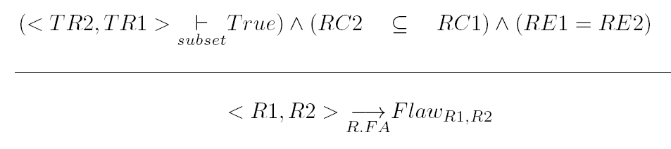
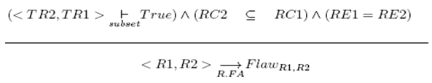
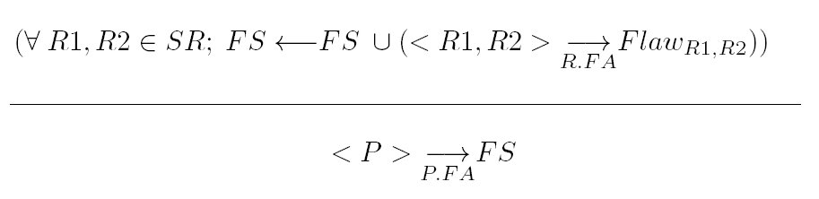
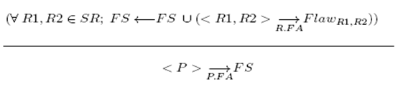
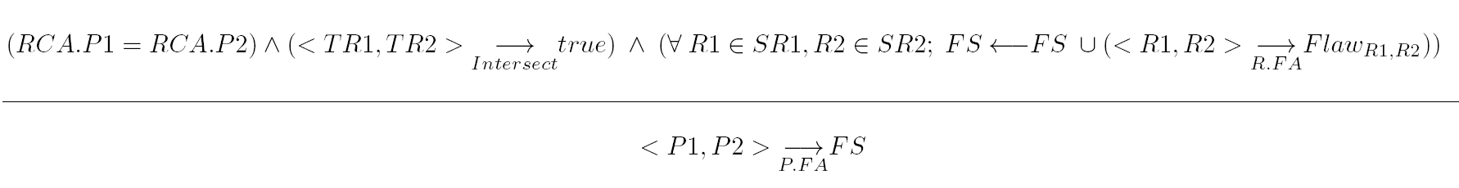
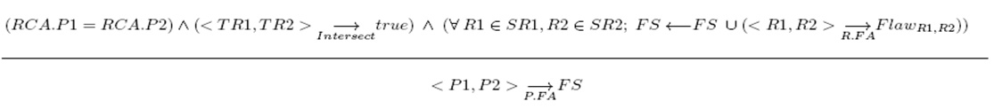
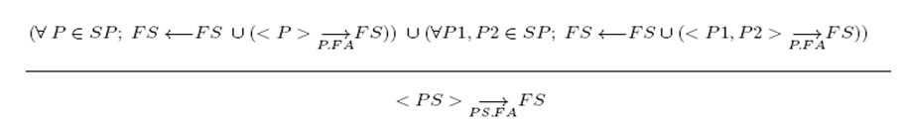
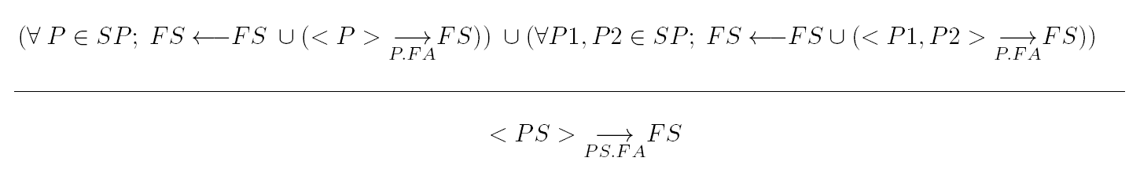
2- Flaws Detection Semantics
Flaws, Conflicts and Redundancy Detection
(4)
(3)
(2)
(1)

Slide 40
2- Flaws Detection Semantics
Case Study
PolicySet : PS1
Policy:P1
Policy:P2
Rule:R1
Rule:R3
Rule:R4
Target (TR1):
any subject
any resource
any action
Rule condition (RC1):
Resource = withdraw
Rule effect (RE1):
permit
Target (TR3):
any subject
any resource
any action
Rule condition (RC3):
Resource = deposit
Rule effect (RE3):
permit
Target (TR4):
any subject
any resource
any action
Rule condition (RC4):
Resource = deposit &
Subject = Joe
Rule effect (RE4):
permit

Slide 41
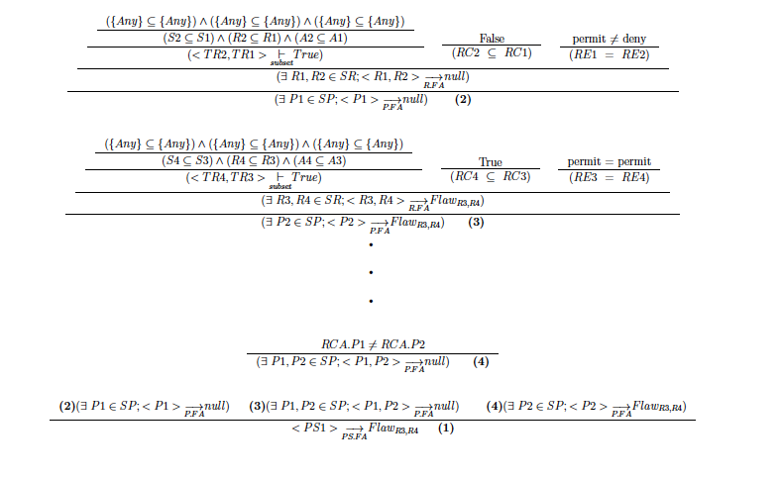
2- Flaws Detection Semantics
Case Study

Slide 42
Outline
Project Overview
Security of Composite Services
  AspectBPEL
  SBA-XACML
Selfish Node Detection in VANET
  Efficient Clustering Model
  Cooperative Detection Model

Slide 43
Problem
Clustering & Routing
  Mobility-based clustering algorithms such as DMAC and APROVE focus on direction and speed to group vehicles.
  However, mobility-based algorithms ignore the QoS metrics
  QoS-based clustering algorithms such as QOLSR and QoS-OLSR focus on bandwidth and energy to group vehicles.
  The QoS-based algorithms ignore the mobility constraints
  Security
    In reputation-based schemes, nodes monitor, detect, and then declare another node to be misbehaving. This announcement is then broadcasted all over the network, leading to discard the misbehaving node from being used in all future routes.
    Limitations: ambiguous collision, false alarms, and non-cooperative decision

Slide 44



Notations
Cluster 1
Cluster 2
5
7
11
7
3
12
12
1
1
CH-2
8
8
13
10
13
2
4
9
14
11
MPR
Cluster-head
Normal Node

Slide 45
Approach
VANET QoS-OLSR:
  Extend the network lifetime while maintaining the Quality of Service
  Reduce the communications overhead
  Prevent the cheating during elections
VANET-DSD:
  Motivate the cooperation
  Detect the selfish/misbehaving vehicles after elections

Slide 46
VANET QoS-OLSR
QoS Model
Cluster-heads election
MPR nodes Selection

Slide 47
QoS Model
QoS(i) = BW(i) x N(i) x DistRatio(i)/VelRatio(i)
Symbol | Significance
i | A node in the network
QoS(i) | Quality of Service Metric of node i
BW(i) | Available bandwidth of i
N(i) | Neighbors of i
ResidualDistance(i) | ResidualDistance(i)= MaximumDistance-CurrentPosition(i)
DistRatio(i) | (ResidualDistance(i)/MaximumDistance)
AvgSpeed | AvgSpeed= Total distance/Total time = 2D/(t1 + t2).
VelRatio(i) | Velocity (i)/AvgSpeed

Slide 48
QoS Model
QoS= Bandwidth x Connectivity x Distance/velocity
Propotional relation with the bandwidth:
  more reliability
Propotional relation with the connectivity:
  less percentage of MPRs & overhead
Propotional relation with the distance:
  more stability
Inversely proportional relation with the velocity:
  more & more stability

Slide 49


Cluster-Heads Election
I am the cluster-head
QoS=500
QoS=300
Ack message
QoS=300
QoS=200
QoS=100
QoS=500
Ack message
I am the cluster-head
QoS=800

Slide 50

MPRs Selection
Route Time(1)= 10
Route Time(2)= 10
Node 8
Phermone(1)=480-10=470
Node 1
5
Node 6
ant1
QoS=280
6
11
Encrypt QoS
3
12
QoS=300
ant1-1
QoS=200
Decrypt QoS
ant2
1
1
CH-2
8
8
13
10
2
4
ant2-1
1
Encrypt QoS
14
8
11
Phermone(2)=500-10=490
MPR Node
Cluster-head Node
Normal Node
Phermone(i)=QoS(i)-Route Time(i)

Slide 51
Factors to Evaluate
Percentage MPRs: The number of elected MPR nodes.
Percentage of stability: current number of nodes in each cluster divided by the previous number of nodes in it
End-to-End delay: the average number of hops needed to transfer data between the source and the destination
Packet Delivery Ratio: # of received packets/ # of sent packets by the source.
Bandwidth Average Difference: it is the bandwidth difference between the path having the maximal bandwidth value and the path currently selected.

Slide 52
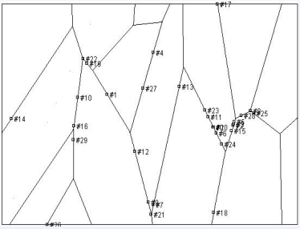
Simulation Area
A simulation area of 3000 x 1000 m

Slide 53
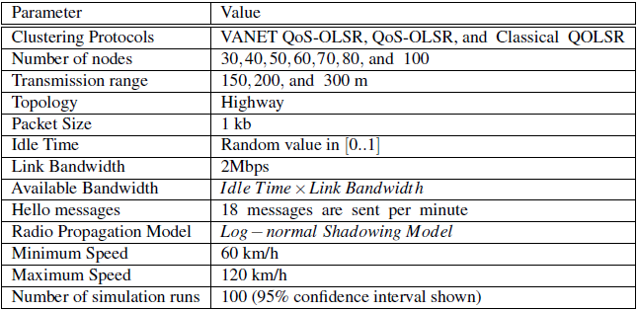
Simulation Parameters

Slide 54
Simulation Results

Slide 55


Selfish/Misbehaing Nodes Problem
Will the vehicles follow this protocol or not?
Questions on mind:
  Why should I pay time & resources serving as MPR for nothing?
  What is the return?

Slide 56

Definition of Selfish Nodes
Selfish nodes in VANET are rational nodes
that prefer to over-speed or under-speed on
the road instead of spending their resources
and time without receiving return.
Types of selfish nodes
  During elections
  After elections

Slide 57
Impact of Selfish Nodes

Slide 58
VANET- DSD: Cooperative Detection Model
Payment & Reputation
Network Services Distribution
Detection Mechanism

Slide 59
Payment and Reputation
Payment(12)= QoS(12)-QoS(1)=500-460=40
Payment(8)= QoS(13)-QoS(8)=510-450=60
5
QoS=300
QoS=400
QoS=500
6
6
7
7
11
QoS=460
7
3
12
QoS=450
QoS=510
12
1
CH-2
1
8
8
13
13
2
13
10
4
9
14
11
Reputation(12)=Reputation(12)+Payment(12)=100+40=140
Reputation(1)=Reputation(1)+Payment(1)=100+60=160
MPR
Cluster-head
Normal Node

Slide 60
Reputation and Network Service Distribution
Available bandwidth=1000 Mb/s
Reputation=109
Reputation=130
Reputation=116
1
2
3
Total Reputation=109+130+116=355
Reputation Ratio=109/355
Reputation Ratio=130/355
Reputation Ratio=116/355
1
2
3
BW share=109/355x1000
BW share=130/355x1000
BW share=116/355x1000
1
2
3

Slide 61
Detection Mechanism
Watchdogs Monitoring
Sharing
Aggregation
Information Dissemination

Slide 62

Monitoring
Cluster 1
Cluster 2
5
Overhear
3
7
11
6
Packet P1
7
10
2
12
1
CH-2
1
8
8
13
14
4
11
9
MPR
Watchdog
Cluster-head
Normal Node

Slide 63

Sharing
Cluster 1
Cluster 2
1 is cooperative
5
1 is cooperative
1 is cooperative
3
7
11
1 is selfish
1 is cooperative
6
7
10
2
12
1
CH-2
1
8
8
14
13
11
4
1 is cooperative
9
MPR
Watchdog
Cluster-head
Normal Node

Slide 64
Aggregation – Why Dempster-Shafer
The usefulness of Dempster–Shafer in representing and combining different types of evidences coming from independent sources
The fact that Dempster–Shafer represents uncertain evidences, which makes it appealing to model the ambiguity in the detection caused by the high mobility of vehicles and the channel collisions
The good reputation of Dempster–Shafer in many critical fields like investigating crimes and diseases.

Slide 65
Aggregation Example
Watchdog A (reputation = 0.9):
m1(C) = 0.9 (Vehicle 1 is cooperative)
m1(U) = 0.1 (watchdog 1 is uncertain)
m1(S) = 0 (M is selfish)
Watchdog B (reputation = 0.8):
m2(C) = 0 (Vehicle 1 is cooperative)
m2(U) = 0.2 (Vehicle 1 is selfish)
m2(S) = 0.8 (watchdog 2 is uncertain)

Slide 66



Information Dissemination
Cluster 1
Cluster 2
5
3
7
11
6
7
10
2
1 is cooperative
1 is cooperative
12
1
CH-2
1
8
8
13
14
4
11
9
MPR
Watchdog
Cluster-head
Normal Node

Slide 67
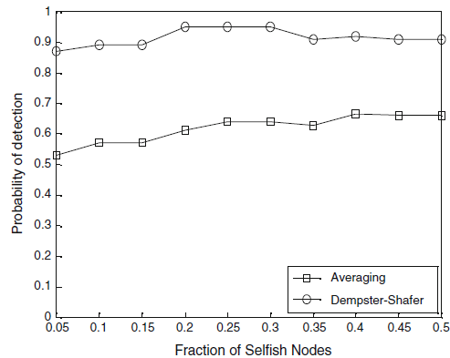
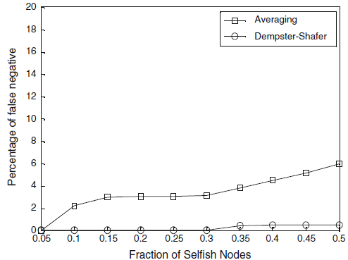
Simulation Results

Slide 68
Related Publications
A Cooperative Watchdog model based on Dempster-Shafer for Detecting Misbehaving Vehicles. Accepted in the Journal of Computer Communications, 2014, Elsevier
A Dempster-Shafer based Tit-for-Tat Strategy to Regulate the Cooperation in VANET using QoS-OLSR Protocol. Accepted in the Journal of Wireless Personal Communications, 2013, Springer
Reputation-Based Cooperative Detection Model of Selfish Nodes in Cluster-based QoS-OLSR Protocol. Accepted in the Journal of Wireless Personal Communications, 2013, Springer
XrML-RBLicensing Approach Adopted to the BPEL process of Composite Web services. In the Journal of Service Oriented Computing, 7(3): 217-230, 2013, Springe
Common Weaving Approach in Mainstream languages for Software Security Hardening. In the Journal of Systems and Software, 86(10): 2654-2674, 2013, Elsevier
New XACML-AspectBPEL Approach for Composite Web Services Security. In the International Journal of Web and Grid Services, 9(2): 127-145, 2013, Inderscience
Vanet-QOLSR: QoS-based Clustering OLSR Protocol for Vehicular Ad hoc Networks. In the Journal of Computer Communications, 36(13): 1422-1435, 2013, Elsevier
A Novel Aspect-Oriented BPEL Framework for the Dynamic Enforcement of Web Services Security. In the International Journal of Web and Grid Services, 8(4): 361–385, 2012, Inderscience
A synergy Between Context-Aware and AOP to Achieve Highly Adaptable Web Services. In the Journal of Service Oriented Computing, 6(4): 379-392, 2012, Springer

Slide 69
Questions?
Thank You…☺

